Slide 1

Deliverable 2
Project Process
IS 436

Slide 2
Who Are We?
Muhammad Hamza - Project Manager
Siril Pattammady - Systems Developer
Josh Johnson - Systems Analyst
Khadija Shafiq - Business Analyst
Jay Patel - Network Engineer
Shaikha Al Shamsi - Requirement Analyst

Slide 3


Recap of Osiris Merger w/ Smith and Nephew
The Osiris to Smith and Nephew merger has lead to a large scale integration project for laptop deployment and network development. This involves the implementation of the Smith and Nephew information technology department to create a standalone windows image, to supply necessary resources, and to configure systems on a user to user need basis and as a company as a whole.

Slide 4
Functional Requirements
Process-Oriented
The system shall allow new laptop deployment
The system shall allow new users to merge with new domain
The system shall allow new IOT devices to be connected
The system shall allow request from end users for changes that are needed
The system shall allow different departments to be interconnected
The system shall be assigned to an order to cash ERP System
The system shall allow analysts and developers to make changes as needed
The system shall be allowed to log existing data.
The system shall have recovery measures for any potential outage.

Slide 5
Non Functional Requirements
Operational/Performance
The system should uphold data integrity
The system should be readily available for users and workers
The system should be manageable by analysts and developers
The system should be secure and recoverable for potential incident
The system should be maintainable after transition from merger
The system should be fairly reliable after all upgrades.
The system should improve productivity and service as ‘old’ system is removed and upgraded.
The system should allow users to login or create new login and password
The system should allow analysts and developers to make changes
The system should allow portability and universal software/OS to be uploaded throughout devices.

Slide 6
Non Functional Requirements Cont.
Security
The system should uphold data integrity
The system should implement firewalls and protection throughout devices
The system should ensure customer information is protected following HIPAA standards.
Cultural and Political
The system should ensure personal and customer information is protected under law and HIPAA compliant.
The merger should allow both companies to work together and become one company.
Should allow company standards and ethical workplace behaviour.

Slide 7
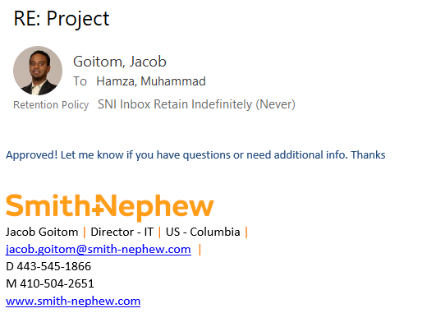
Contact 1
Name of Interviewee: Jacob Goitom
Position of Interviewee: Director of IT, Smith & Nephew
Date and Time of Interview: 10/13/2019
Name of Interviewer: Muhammad Hamza
Questions asked:
Is the current ERP system efficient enough to handle new workload?
What is the timeline for laptop deployments?
Who is going to Image the Machines?
Is there enough on-site support to assist with the integration?
What resources will be required to complete this project in a timely manner?

Slide 8
Contact 2
Name of Interviewee: Joey Caceres
Position of Interviewee: Systems Administrator, Smith & Nephew
Date and Time of Interview: 10/13/2019
Name of Interviewer: Muhammad Hamza
Questions to be asked:
What is your role in the current processes and ERP handling?
How many laptops can be deployed per day to meet quota?
Is your team a responsible team to complete the task assigned?
What resources will be required to complete this project in a timely manner?
What processes can you simplify to ease the task and allow for a better workflow to exist?

Slide 9
Use Cases
Use Case# 1 Deployment Laptops Priority: High
Use Case# 2 Conversion from QAD to SAP Priority: High
Use Case# 3 Uploading Software on Devices Priority: High

Slide 10
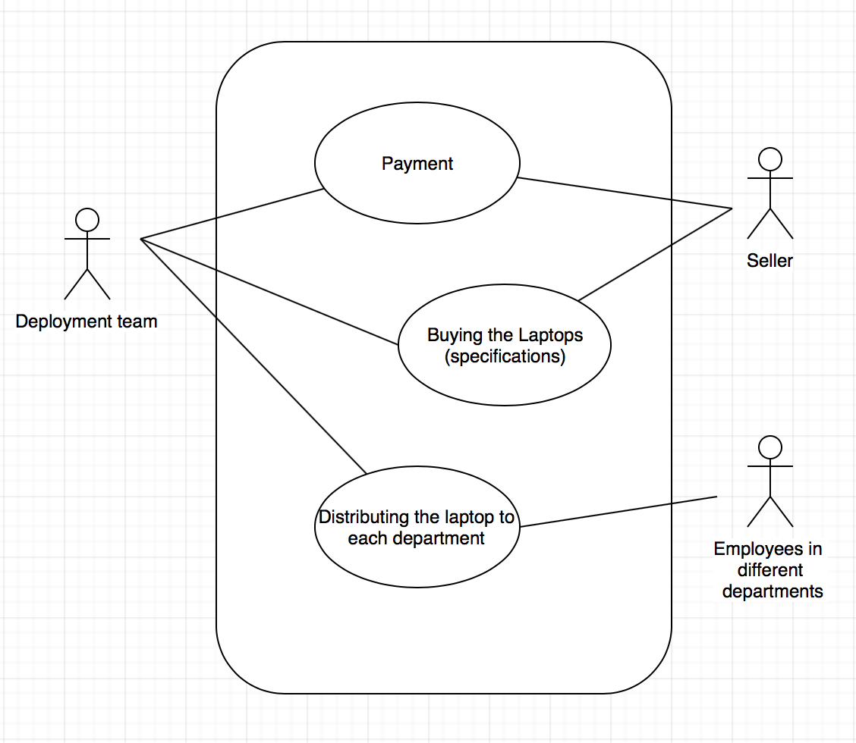
Use Case# 1 Deployment Laptops Diagram

Slide 11
Use Case 3 Use Case Document
Actor: Software deployment team
Description: Process of uploading software packages on end users devices
Trigger: When Laptops are all deployed
Type: Internal
Preconditions:
Laptops deployed to department
Software team has all software packages on hand
Time frame of when software has to be deployed on devices
Normal Course:
Obtain all laptops on hand
Software team to order all licensing agreements and packages for applications to be downloaded
Arrange time for deployment
Have teams login to laptops and import all software packages/licensing on devices
Have all laptops completed and ready for user to login
Postconditions:
Software packages on all devices
User login and passwords created for all work users
Laptops and devices finished deployment

Slide 12
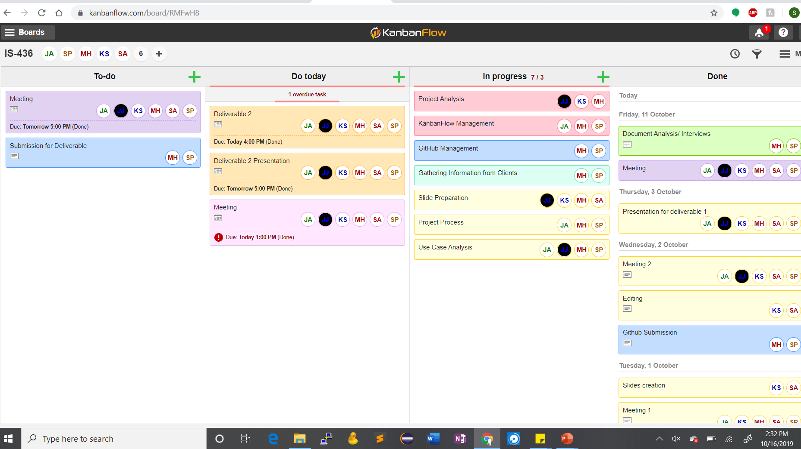
KanbanFlow

